Slide 1
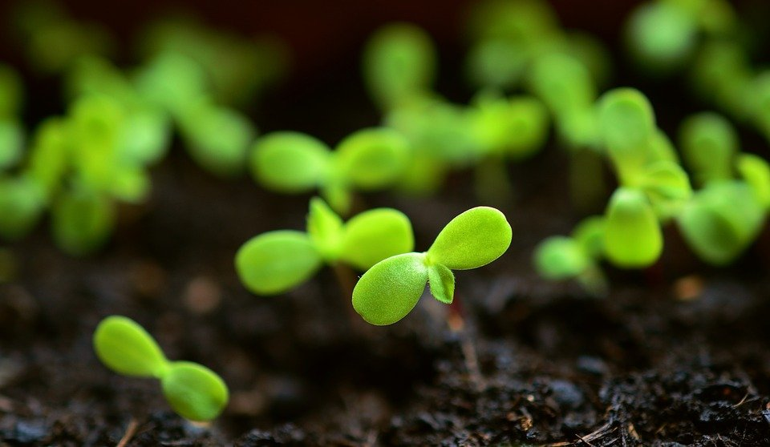
DesignX
UX Design Final Presentation

Slide 2
DesignX Team Members
Dom
Varsha
Jonah
Major: Computer Science
Graduation: Spring 2022
Major: Computer Science
Graduation: Spring 2023
Major: Computer Science
Graduation: Fall 2022

Slide 3
Design Challenge
You have been hired to create an application, website, tool, etc. that will allow customers to perform the activities most important to them when seeking to fulfill specific transportation needs.

Slide 4
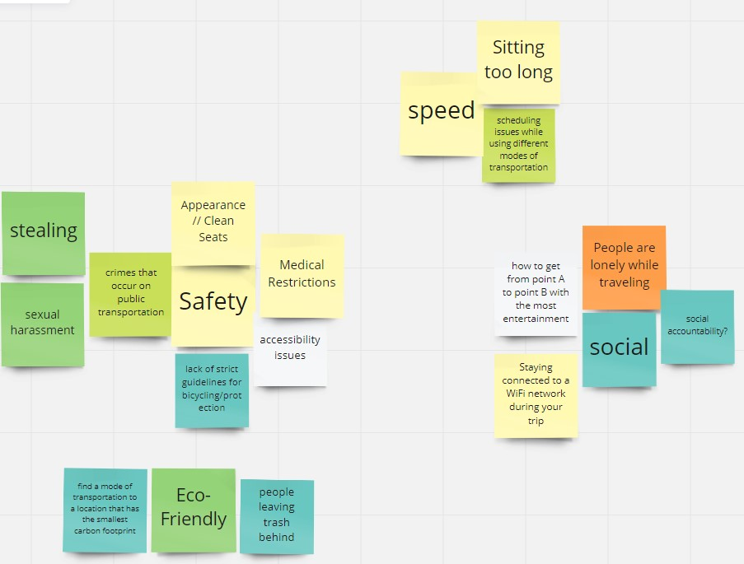
Scoping
Brain Dump Exercise:
What is transportation? What does it mean to us? Who would we be designing for? What problems are there? How can we change the rules? How can we be weird or different?
Key Takeaways:
Transportation is a broad topic, there are hundreds of ways we could go about creating a solution.
Hypothesis - “Climate change is a problem we frequently see associated with transportation. We want to improve the way we travel for those who want to be more environmentally friendly.”
Miro

Slide 5
User Research/Analysis
Established a hypothesis, now needed to know who potential users are and what solutions we could offer. Accomplished this using…
User Interviews
User Surveys
Data Analysis
Creating User Personas
Notes:
How did you gather information on the problem and define your end-users? (User Research/Analysis)

Slide 6
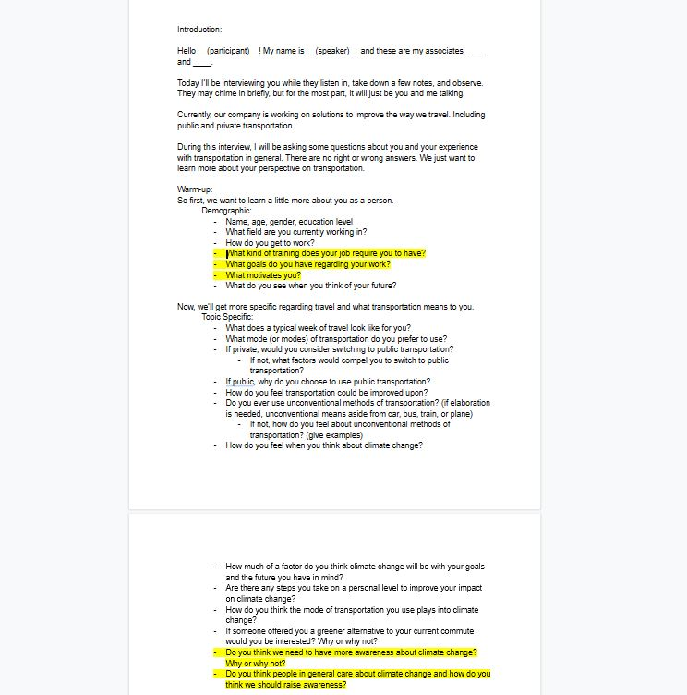
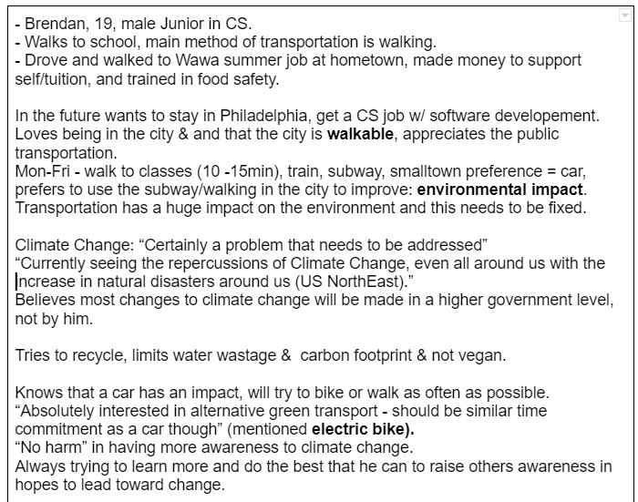
User Interviews

Slide 7
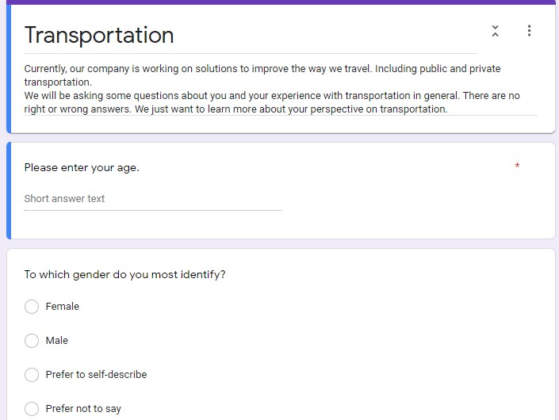
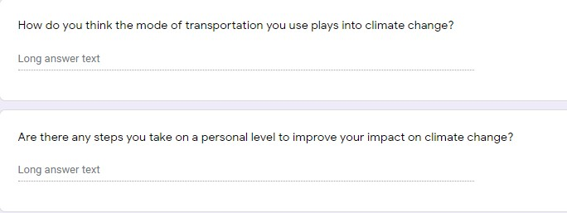
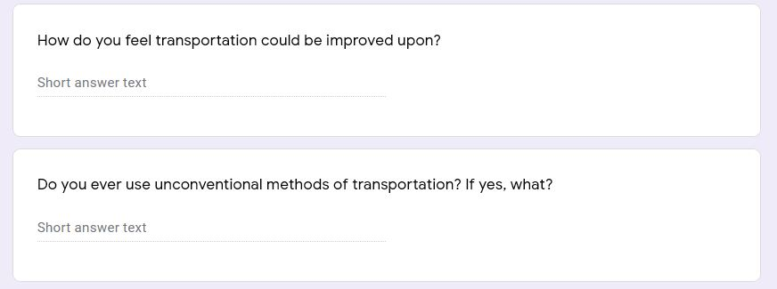
User Survey
Things to consider:
Statement of purpose
Understandable questions
Exploratory questions
Survey length

Slide 8
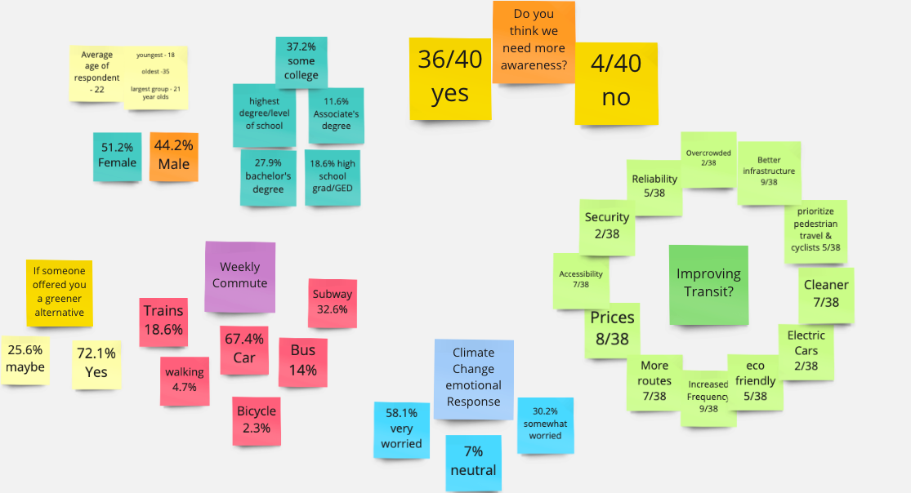
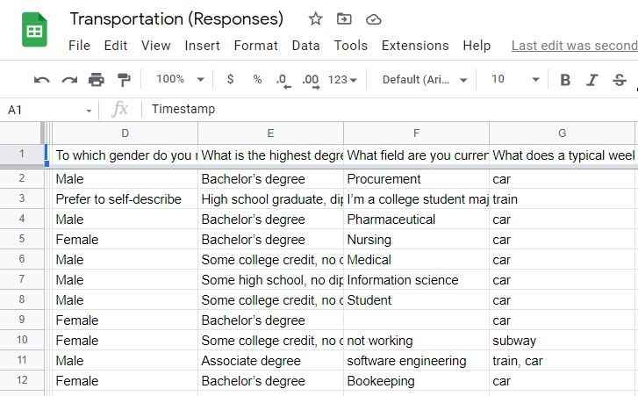
Data Analysis

Slide 9
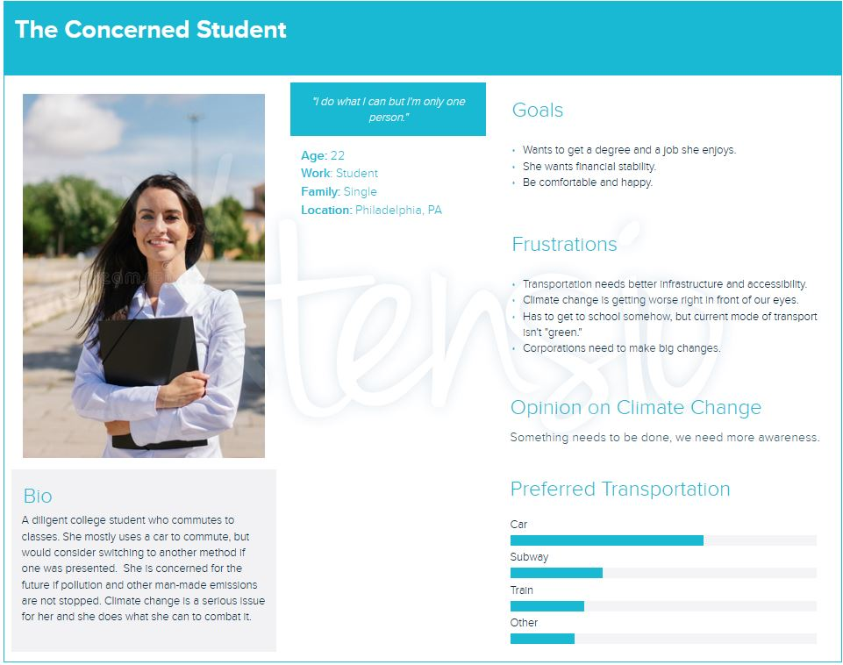
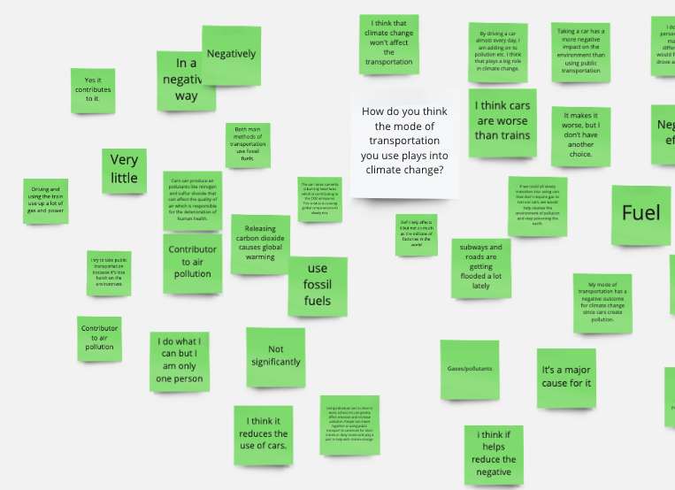
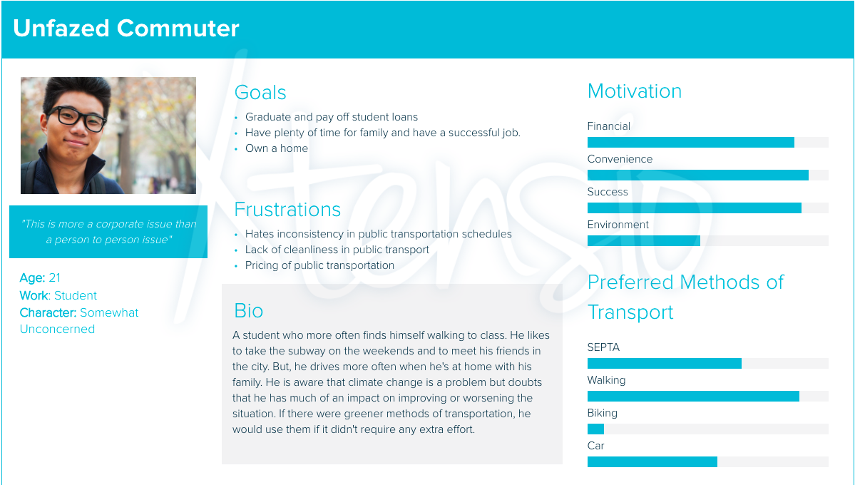
User Personas

Slide 10
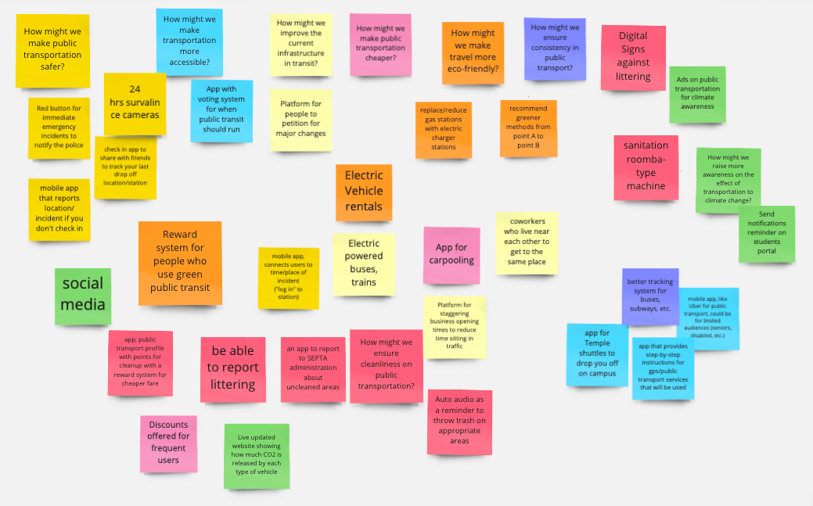
Ideation

Slide 11
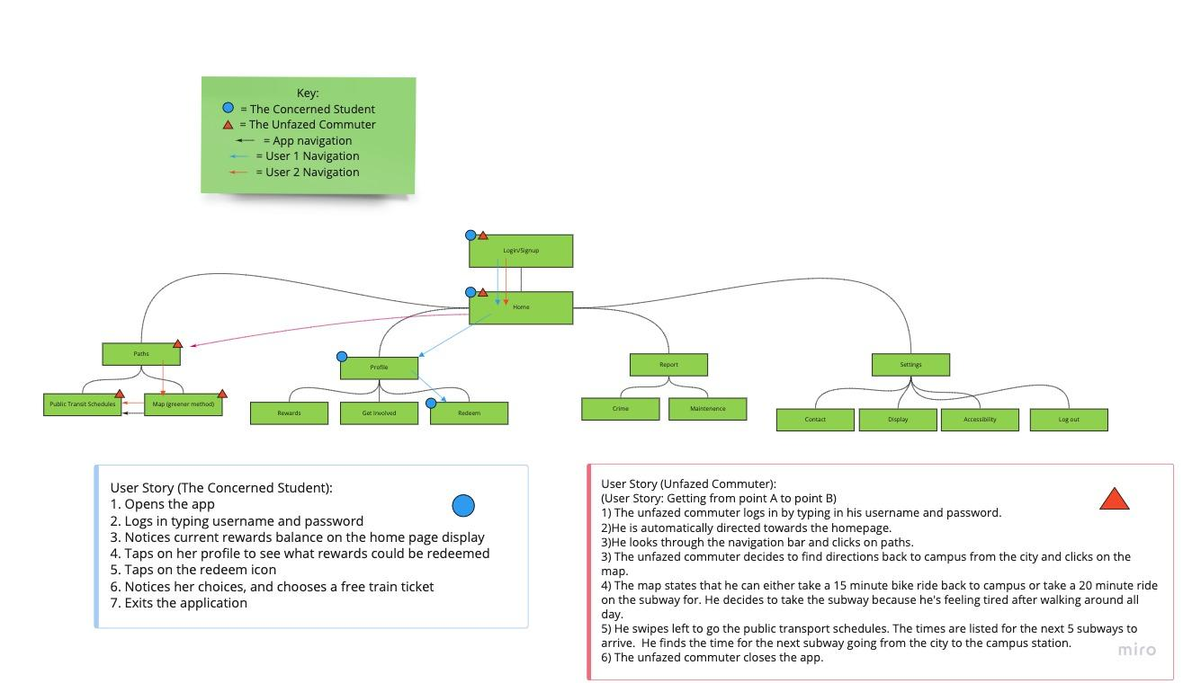
Site Map/User Flow

Slide 12
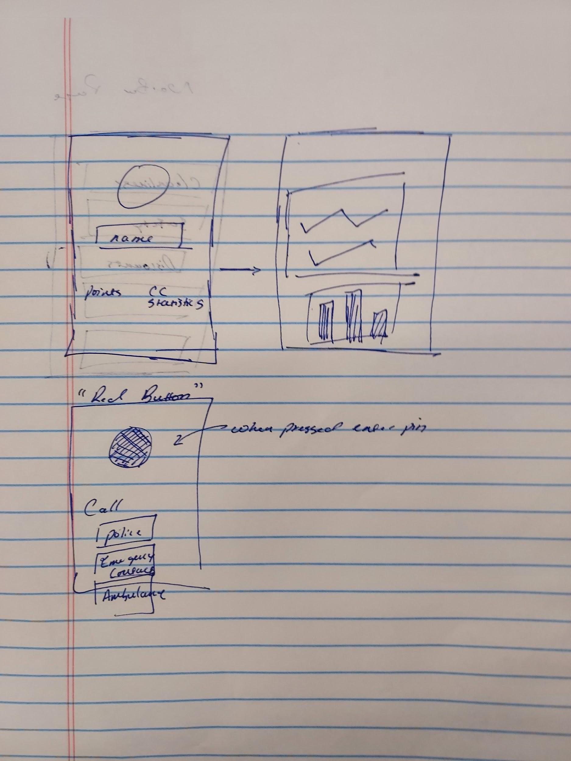
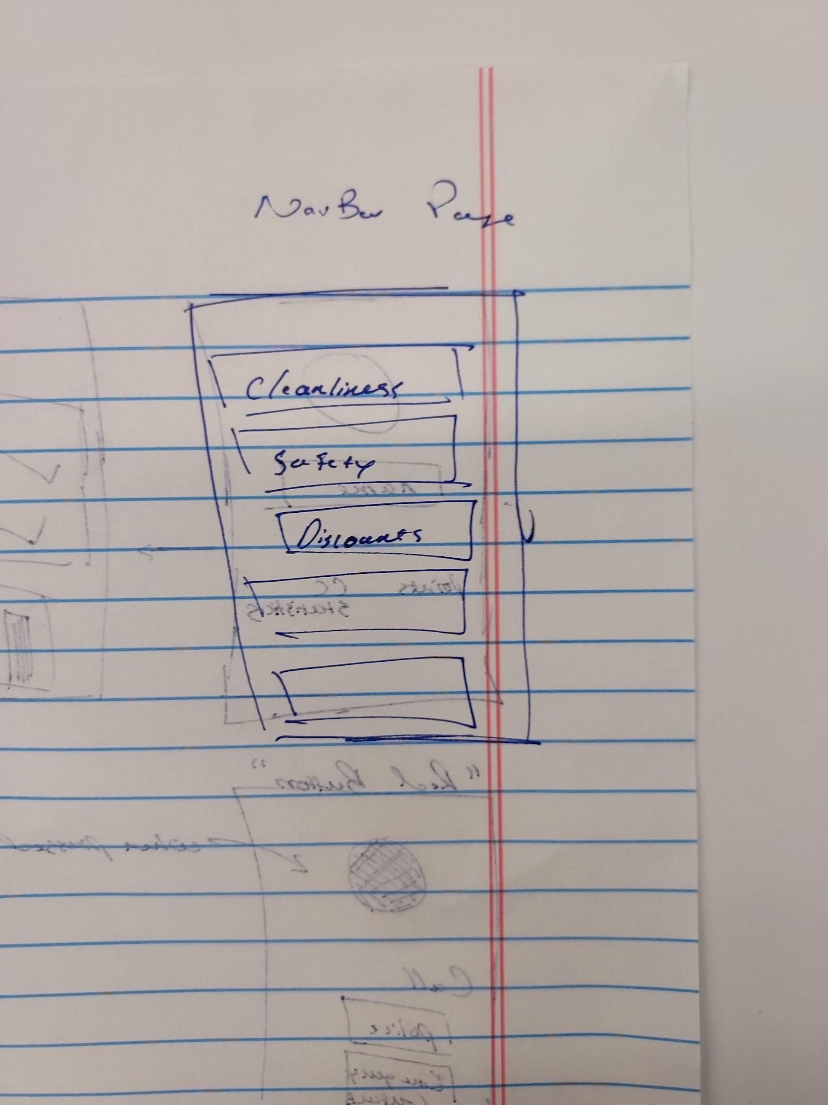
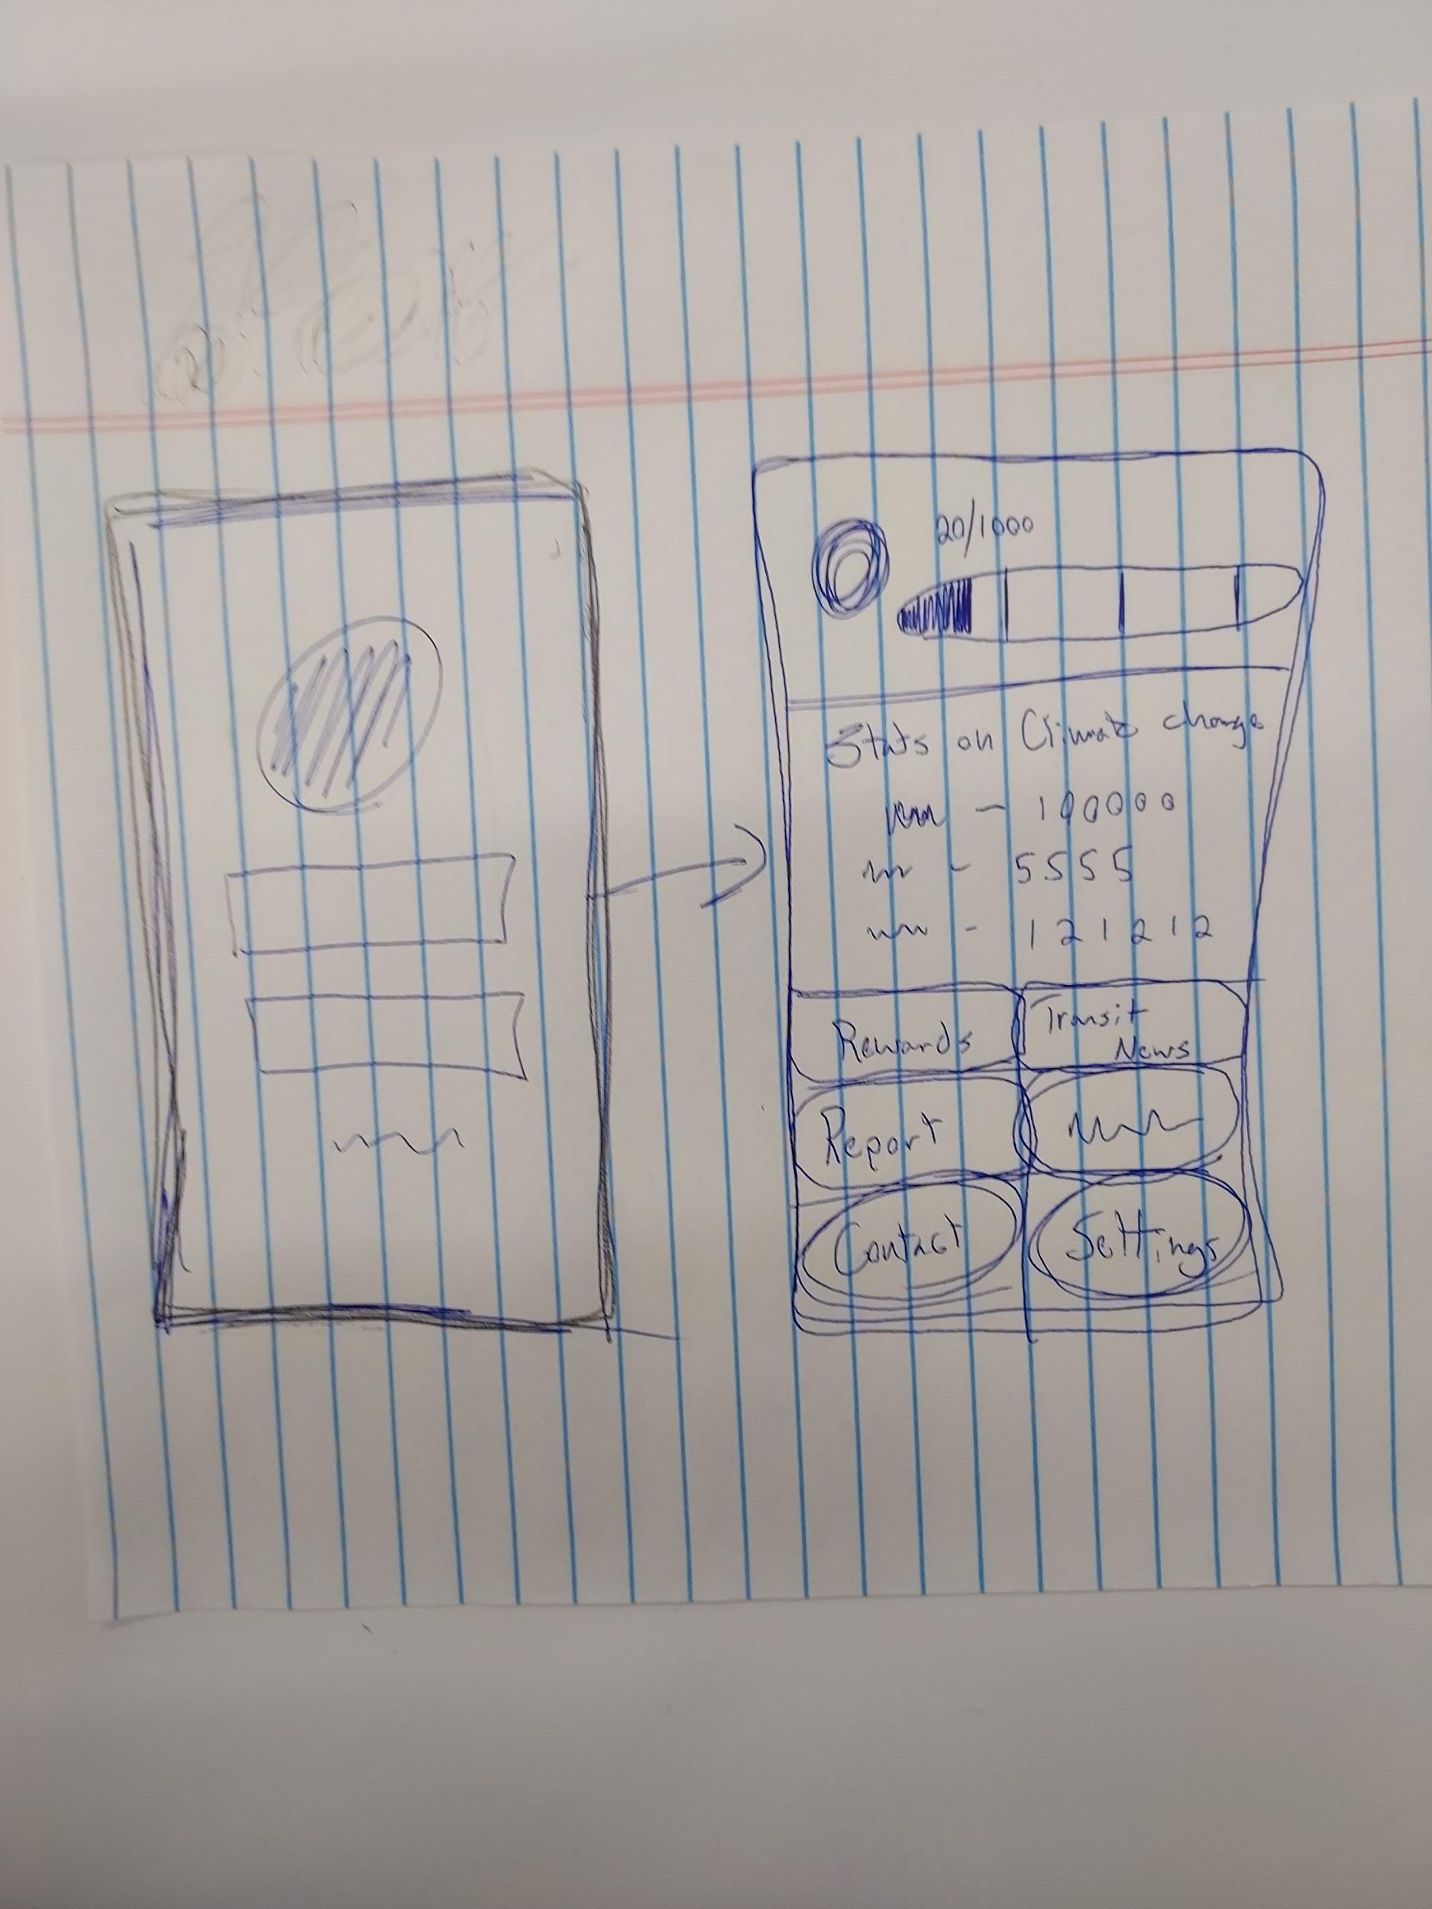
Sketches

Slide 13
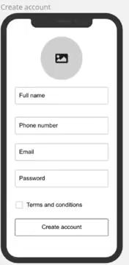
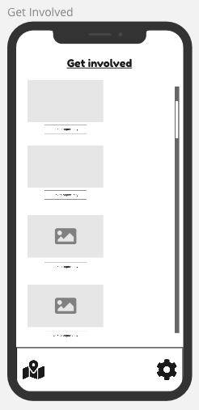
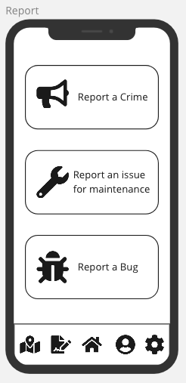
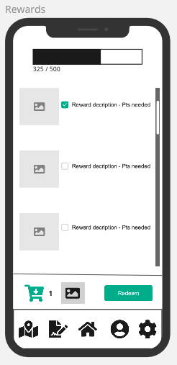
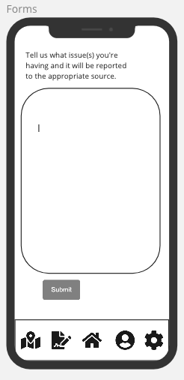
Design
Notes:
The design solution we have created works to ensure a more user friendly transportation system

Slide 14

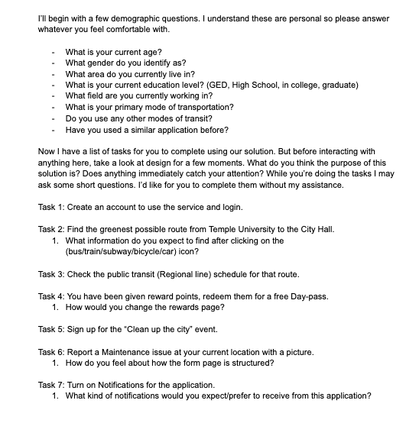
Validation & Analysis
We ended up working with 7 users during the course of our validation. They were mostly college students and for the most part fit into one or the other user persona. They gave us the insights we needed to complete the next step.

Slide 15
Iteration (What steps will we be taking?)
Account Creation
Users expected a different box for first and last names.
Get Involved Page
Will be able to see the number of people signed up for each activity.
Displays if any friends are signed up as well.
Settings
Notifications
If maintenance requests have been updated.
If there are enough points to redeem.
If there are new events to sign up for.
Reminders for upcoming events.

Slide 16
Questions/comments
Thank you for listening

